Slide 1
Chapter 1 Introduction
Programming 3
CSCI 2308

Slide 2
Topics Covered
Java Overview
Java Libraries (API’s)
Java Frameworks
Basic Programming Concepts
Comments, Data Types, Arithmetic Operators, Relational Operators, Bitwise Operators, Logical Operators, Assignment Operators, Arrays, Reference Datatype: Strings, Control Flow
Java enum
Wrapper Classes
Functions
Object Oriented Programing (OOP)
Exception Handling
File I/O
Collections
Java lambda and Functional Programming

Slide 3
Java Overview
Java is a programming language and computing platform first released by Sun Microsystems in 1995.
There are lots of applications and websites that will not work unless you have Java installed, and more are created every day.
Java is fast, secure, and reliable.
From laptops to datacenters, game consoles to scientific supercomputers, cell phones to the Internet, Java is everywhere.
Currently, Java is one of the most popular and influential programming languages.

Slide 4
Java Overview (cont.)
Simple
Simpler than C++
Object Orientated
Designed from the start to be object-oriented
Distributed
Built in support for Internet protocols, URL’s, HTTP etc.
Support for distributed objects, RMI, CORBA etc.
Robust
Difficult to create memory leaks, go beyond the end of an array, corrupt stack or code
Secure
Implements several security mechanisms to protect your system against harm
Architecture Neural, Portable
Runs on PC, MAC, Unix, VMS
Interpreted
“Compiler” converts code into machine independent “bytecodes”
High Performance
With Just-In-Time (JIT) compiler still several times slower than native C++
Oracle works on improving the performance
Multithreaded
Multithread programming is smoothly integrated in Java
Dynamic
Libraries can change without recompiling programs that use them

Slide 5
Java Libraries (API’s)
The usefulness of Java is greatly enhanced by the large range of platform independent libraries available, here some popular standard libraries:
JavaFX - The latest GUI environment that Java uses, its predecessors are AWT and Swing.
2D - Transformations, stroked fonts, pattern fill, textures etc.
BEANS - Java based components, plug commercial components into your applications.
NIO - Defines buffers, which are containers for data.
JDBC - Standard Interface between Java and SQL databases
SQL - Accessing and processing data stored in a data source (usually a relational database).
SECURITY - Authentication and authorization, parsing and managing certificates, generating RSA keys etc.
RMI - Remote method invocations between distributed Java applications, and between Java and other languages
Media (audio, video etc.), Share (e.g. whiteboards), Animation, Telephony, 3D (developed by SUN and SGI), cryptography, server.

Slide 6
Java Popular Frameworks
A framework is a general foundation on which different modules of a project can be developed in a very organized and efficient way. The application can have a better flexibility for future additions. Some well-known java frameworks include:
Spring Boot: Provides a good platform for Java developers to develop a stand-alone and production-grade spring application that you can just run.
Struts 2: A tailor-made to develop an application from the beginning to the finish including maintenance support.
Java Server Faces(JSF): It is based on Java EE and it comes with a great set of tools and libraries to develop user-friendly interfaces that Java always lacked.
Hibernate: Used to create robust back-end interface and application to maintain the front-end effortlessly. It gives developers a pass to do operations on the databases through Java.
GWT: A Google Web Toolkit that helps web developers to optimize the web applications better. There are widgets and APIs available to build large-scale application after the JavaScript development is done.

Slide 7
Java Platforms
Standard Edition (Java SE):
Provides the core functionality of the Java programming language. (e.g. basic types, objects, networking, security, database access, GUI, and XML parsing.
Enterprise Edition (Java EE):
Built on top of Java SE and provides an API and runtime environment for developing large-scale, multi-tiered, reliable, and secure network applications.
Micro Edition (Java ME):
Provides an API and a small-footprint virtual machine for running Java applications on small devices, like mobile phones. The API is a subset of the Java SE API, along with special class libraries.
All platforms consist of a Java Virtual Machine (JVM) and an Application Programming Interface (API)

Slide 8
Basic Programming Concepts Comments
The most common used method for comments is the line comment //
When longer comments are needed, you can use the /* and */ comment delimiters
System.out.println("Hello, World!"); // just show a message
public class FirstSample
{ /*
public static void main(String[] args)
{
System.out.println("Hello, World!");
}
*/
}

Slide 9
Basic Programming Concepts (cont.) Data Types: 8 Primitive Types in Java
Category. | Type | Storage Req. | Range (Inclusive)
Integers | byte | 1 byte | –128 to 127 (–2⁷ to 2⁷–1)
 | short | 2 bytes | –32,768 to 32,767 (–2¹⁵ to 2¹⁵–1)
 | int | 4 bytes | –2,147,483,648 to 2,147,483, 647 (–2³¹ to 2³¹–1)
 | long | 8 bytes | –9,223,372,036,854,775,808 to 9,223,372,036,854,775,807 (–2⁶³ to 2⁶³–1)
Floating-Point | float | 4 bytes | + 1.4E-45 to + 3.4028235E+38 (6–7 significant decimal digits)
 | double | 8 bytes | + 4.9E-324 to + 1.7976931348623157E+308 (15 significant decimal digits)
Text | char | 2 bytes (Unicode)
Logical | boolean | 1 bit | {true,false} booleans cannot be converted to or from other types

Slide 10
Basic Programming Concepts (cont.) Data Types
In Java SE 8 and later, you can use the int data type to represent an unsigned 32-bit integer, which has a minimum value of 0 and a maximum value of 2³²-1.
you can use the long data type to represent an unsigned 64-bit long, which has a minimum value of 0 and a maximum value of 2⁶⁴-1.
Unsigned integer example:
int uint = Integer.parseUnsignedInt("4294967295");
System.out.println(Integer.toUnsignedString(uint));

Slide 11
Basic Programming Concepts (cont.) Arithmetic Operators
Operator | Description | Example: A=10, B=20
+ (Addition) | Adds values on either side of the operator. | A + B will give 30
- (Subtraction) | Subtracts right-hand operand from left-hand operand. | A - B will give -10
* (Multiplication) | Multiplies values on either side of the operator. | A * B will give 200
/ (Division) | Divides left-hand operand by right-hand operand. | B / A will give 2
% (Modulus) | Divides left-hand operand by right-hand operand and returns remainder. | B % A will give 0
++ (Increment)* | Increases the value of operand by 1. | ++B gives 21
-- (Decrement)* | Decreases the value of operand by 1. | --B gives 19
*Prefix: Increment/decrement by 1, then use the new value in the expression in which it resides.
*Postfix: Use the current value in the expression in which it resides, then increment/decrement it by 1.

Slide 12
Basic Programming Concepts (cont.) Relational Operators
Operator | Description | Example: A=10, B=20
== (equal to) | Checks if the values of two operands are equal or not, if yes then condition becomes true. | (A == B) is not true.
!= (not equal to) | Checks if the values of two operands are equal or not, if values are not equal then condition becomes true. | (A != B) is true.
> (greater than) | Checks if the value of left operand is greater than the value of right operand, if yes then condition becomes true. | (A > B) is not true.
< (less than) | Checks if the value of left operand is less than the value of right operand, if yes then condition becomes true. | (A < B) is true.
>= (greater than or equal to) | Checks if the value of left operand is greater than or equal to the value of right operand, if yes then condition becomes true. | (A >= B) is not true.
<= (less than or equal to) | Checks if the value of left operand is less than or equal to the value of right operand, if yes then condition becomes true. | (A <= B) is true.

Slide 13
Basic Programming Concepts (cont.) Bitwise Operators
Operator | Description | Example: A=60, B=13
& (bitwise and) | Binary AND Operator copies a bit to the result if it exists in both operands. | (A & B) will give 12 which is 00001100
| (bitwise or) | Binary OR Operator copies a bit if it exists in either operand. | (A | B) will give 61 which is 00111101
^ (bitwise XOR) | Binary XOR Operator copies the bit if it is set in one operand but not both. | (A ^ B) will give 49 which is 00110001
~ (bitwise compliment) | Binary Ones Complement Operator is unary and has the effect of "flipping" bits. | (~A ) will give -61 which is 11000011 in 2's complement form due to a signed binary number.
<< (left shift) | Binary Left Shift Operator. The left operands value is moved left by the number of bits specified by the right operand. | A << 2 will give 240 which is 11110000
>> (right shift) | Binary Right Shift Operator. The left operands value is moved right by the number of bits specified by the right operand. | A >> 2 will give 15 which is 00001111
>>> (zero fill right shift) | Shift right zero fill operator. The left operands value is moved right by the number of bits specified by the right operand and shifted values are filled up with zeros. | A >>>2 will give 15 which is 00001111

Slide 14
Basic Programming Concepts (cont.) Logical Operators
Operator | Description | Example: A=1, B=0
&& (logical and) | Called Logical AND operator. If both the operands are non-zero, then the condition becomes true. | (A && B) is false
|| (logical or) | Called Logical OR Operator. If any of the two operands are non-zero, then the condition becomes true. | (A || B) is true
! (logical not) | Called Logical NOT Operator. Use to reverse the logical state of its operand. If a condition is true then Logical NOT operator will make false. | !(A && B) is true

Slide 15
Basic Programming Concepts (cont.) Assignment Operators
Operator | Description | Example
= | Simple assignment operator. Assigns values from right side operands to left side operand. | C = A + B will assign value of A + B into C
+= | Add AND assignment operator. It adds right operand to the left operand and assign the result to left operand. | C += A is equivalent to C = C + A
-= | Subtract AND assignment operator. It subtracts right operand from the left operand and assign the result to left operand. | C -= A is equivalent to C = C – A
*= | Multiply AND assignment operator. It multiplies right operand with the left operand and assign the result to left operand. | C *= A is equivalent to C = C * A
/= | Divide AND assignment operator. It divides left operand with the right operand and assign the result to left operand. | C /= A is equivalent to C = C / A
%= | Modulus AND assignment operator. It takes modulus using two operands and assign the result to left operand. | C %= A is equivalent to C = C % A
<<= | Left shift AND assignment operator. | C <<= 2 is same as C = C << 2
>>= | Right shift AND assignment operator. | C >>= 2 is same as C = C >> 2
&= | Bitwise AND assignment operator. | C &= 2 is same as C = C & 2
^= | bitwise exclusive OR and assignment operator. | C ^= 2 is same as C = C ^ 2
|= | bitwise inclusive OR and assignment operator. | C |= 2 is same as C = C | 2

Slide 16
Basic Programming Concepts (cont.) The Conditional (Ternary) Operator
Operator | Description | Example
?: | Uses the boolean value of one expression to decide which of two other expressions should be evaluated. | int x = 2; String result = x > 1 ? "a" : "b";

Slide 17
Basic Programming Concepts (cont.) Operators and its Precedence
Operators | Associativity
[] . () (method call) | Left to right
! ~ ++ -- + (unary) – (unary) () (cast) new | Right to left
* / % | Left to right
+ - | Left to right
<< >> >>> | Left to right
< <= > >= instanceof | Left to right
== != | Left to right
& | Left to right
^ | Left to right
| | Left to right
&& | Left to right
|| | Left to right
?: | Right to left
= += -= *= /= %= &= |= ^= <<= >>= >>>= | Right to left

Slide 18
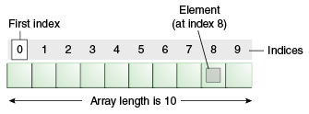
Basic Programming Concepts (cont.) Arrays
Array is a data structure that stores a collection of values of the same type.
You access each individual value through an integer index.
// create an array of integers
int anArray[] = new int[10];
anArry[0] = 20;
int[] anArray = {
100, 200, 300,
400, 500, 600,
700, 800, 900, 1000
};
int[] a = new int[100];
for (int i = 0; i < 100; i++)
a[i] = i; // fills the array with 0 to 99

Slide 19
Basic Programming Concepts (cont.) Arrays
Multidimensional arrays use more than one index to access array elements. They are used for tables and other more complex arrangements.
int[][] a = new int[100][100];
for (int i = 0; i < 100; i++)
for (int j = 0; j < 100; j++)
a[i][j] = i; // fills the array rows with 0 to 99

Slide 20
Basic Programming Concepts (cont.) Reference datatype: Strings
Conceptually, Java strings are sequences of Unicode characters.
Each quoted string is an instance of the String class:
Some popular functions:
length()
charAt(n)
indexOf(s)
"+" sign to concatenate two strings
substring(s, l)
equals(), equalsIgnoreCase()
startWith(), endWith()
split()
String e = ""; // an empty string
String greeting = "Hello";

Slide 21
Basic Programming Concepts (cont.) Control Flow
if statement:
switch Statement
switch (choice) {
case 1:
...
break;
case 2:
...
break;
default: //bad input
...
break;
}
if (condition)
statement/block
else
statement/block

Slide 22
Basic Programming Concepts (cont.) Control Flow
for() statement:
while() Statement
do…while() Statement
for(var. ini.; con.; step)
Statement/block
do
Statement/block
while(condition);
while(condition)
Statement/block

Slide 23
Java enum
An enum type is a special data type that enables for a variable to be a set of predefined constants.
The variable must be equal to one of the values that have been predefined for it.
E.g.: directions (values of NORTH, SOUTH, EAST, and WEST).
Because they are constants, the names of an enum type's fields are in uppercase letters.
public enum Directions { NORTH, SOUTH, EAST, WEST}
public class Test{
public static void main(String[] args) {
Directions dirc = Directions.NORTH; }

Slide 24
Java enum (cont.) Another Example
public enum Grade {
A(2000),
B(1500),
C(1000),
D(500);
private int val;
Grade(int val){
this.val = val;
}
public int salary(){
return val;
}
}
public class Test{
public static void main(String[] args) {
Grade grade = Grade.A;
//int salary =
Grade.A.salary();
int salary =
grade.salary(); }

Slide 25
Wrapper Classes
Wrapper class in java provides the mechanism to convert primitive into object and object into primitive.
Auto-boxing and auto-unboxing feature converts primitive into object and object into primitive automatically and vice-versa.
Wrapper classes allow programmer to parse primitive data from String through the pre-defined methods.

Slide 26
Wrapper Classes (cont.)
public static void main(String args[]) {
// boxes int to an Integer object
Integer x = 5;
// unboxes the Integer to a int
x = x + 10;
System.out.println(x);
//parsing data from String
double pi = Double.parseDouble("3.14");
}
Primitive Type | Wrapper class
boolean | Boolean
char | Character
byte | Byte
short | Short
int | Integer
long | Long
float | Float

Slide 27
Functions
The function in Java is called method.
A method is a named sequence of code that can be invoked by other Java code.
A method takes some parameters, performs some computations and then optionally returns a value (or object).
Methods can be used as part of an expression statement.
public float convertCelsius(float tempC) {
return( ((tempC * 9.0f) / 5.0f) + 32.0 );
}

Slide 28
Functions (cont.)
A method signature specifies:
The name of the method.
The type and name of each parameter.
The type of the value (or object) returned by the method.
The checked exceptions thrown by the method.
Various method modifiers.
modifiers type name ( parameter list ) [throws exceptions ]
public float convertCelsius (float tCelsius ) {}
public boolean setUserInfo ( int i, int j, String name )
throws IndexOutOfBoundsException {}

Slide 29
Object Oriented Programming
Object-oriented programming (or OOP for short) having replaced the "structured" procedural programming techniques
The key to being most productive in OOP is to make each object responsible for carrying out a set of related tasks.
Vocabulary of OOP
A class is the template or blueprint from which objects are actually made.
When you construct an object from a class, you are said to have created an instance of the class.
Encapsulation is nothing more than combining data and behavior in one package and hiding the implementation of the data from the user of the object.
The data in an object are called its instance fields.
The procedures that operate on the data are called its methods.
The instance fields values is current state of the object.

Slide 30
Object Oriented Programming (cont.) UML Class to Java Code
UML: Unified Modeling Language
Java Code
public class Rectangle
{
private double width;
private double length;
public void setWidth(double w)
{ width = w;
}
public void setLength(double len)
{ length = len;
}
public double getWidth()
{ return width;
}
public double getLength()
{ return length;
}
public double getArea()
{ return length * width;
}
}
Rectangle
width : double
length : double
+ setWidth(w : double) : void
+ setLength(len : double): void
+ getWidth() : double
+ getLength() : double
+ getArea() : double

Slide 31
Object Oriented Programming (cont.) Java Access Modifiers
Java access modifiers are used to apply information hiding concepts.
 | default (no modifier) | private | protected | Public
Same Class | Yes | Yes | Yes | Yes
Same package subclass | Yes | No | Yes | Yes
Same package non-subclass | Yes | No | Yes | Yes
Different package subclass | No | No | Yes | Yes
Different package non-subclass | No | No | No | Yes

Slide 32
Object Oriented Programming (cont.) static Modifier
When a variable is declared with the keyword static, its called a class variable.
Static variables are initialized only once , at the start of the execution .
These variables will be initialized first, before the initialization of any instance variables.
All instances share the same copy of the variable.
A class variable can be accessed directly with the class, without the need to create a instance.

Slide 33
Object Oriented Programming (cont.) static Modifier
When a method is declared with the keyword static, then it will belong to the class and not to the object(instance).
It access only static data.
It can not access non-static data (instance variables)
It can call only other static methods
It not call a non-static method from it.
It can be accessed directly by the class name and doesn’t need any object
It cannot refer to this or super keywords in anyway

Slide 34
Object Oriented Programming (cont.) final Keyword
final variable
final variables are nothing but constants.
We cannot change the value of a final variable once it is initialized.
final method
A final method cannot be overridden.
this means even though a sub class can call the final method of parent class without any issues but it cannot override it.
We cannot extend a final class.

Slide 35
Object Oriented Programming (cont.) Constructor
A constructor has the same name as the class.
A class can have more than one constructor.
A constructor can take zero, one, or more parameters.
A constructor has no return value.
A constructor is always called with the new operator.

Slide 36
Object Oriented Programming (cont.) Inheritance
Inheritance can be defined as the process where one class acquires the properties (methods and fields) of another.
With the use of inheritance the information is made manageable in a hierarchical order.
extends is the keyword used to inherit the properties of a class.
The figure in next slide shows the syntax of extends keyword.

Slide 37
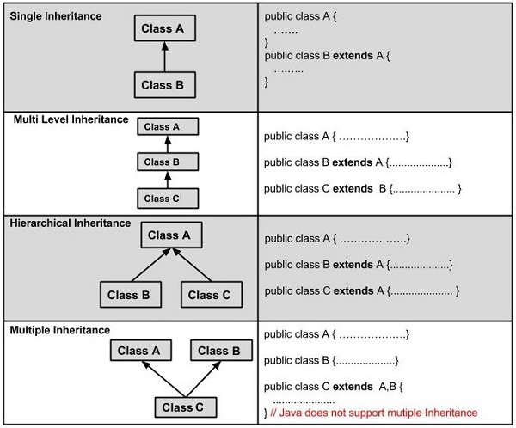
Object Oriented Programming (cont.) Inheritance

Slide 38
Object Oriented Programming (cont.) Inheritance
PartTimeEmployee | FullTimeEmployee | Employee
No Name Job WorkingHour HourRate | No Name Job HireDate Grade | No Name Job
set... get… | set... get… | set... get…
public class Employee { …
public class FullTimeEmployee extemds Employess { …
public class PartTimeEmployee extemds Employess { …

Slide 39
Object Oriented Programming (cont.) Overriding
Overriding means to override the functionality of an existing method.
The argument list should be exactly the same as that of the overridden method.
The return type should be the same or a subtype of the return type declared in the original overridden method in the superclass.
The access level cannot be more restrictive than the overridden method's access level.
For example: If the superclass method is declared public then the overriding method in the sub class cannot be either private or protected.
A method declared private cannot be overridden.
A method declared final cannot be overridden.
A method declared static cannot be overridden but can be re-declared.
Constructors cannot be overridden.

Slide 40
Object Oriented Programming (cont.) Abstract Class
A class which contains the abstract keyword in its declaration is known as abstract class.
Abstract classes may or may not contain abstract methods
i.e., methods without body ( public void get(); )
If a class has at least one abstract method, then the class must be declared abstract.
If a class is declared abstract, it cannot be instantiated.
To use an abstract class, you have to inherit it from another class, provide implementations to the abstract methods in it.
If you inherit an abstract class, you have to provide implementations to all the abstract methods in it.
public abstract class Employee { ...

Slide 41
Object Oriented Programming (cont.) Polymorphism
Polymorphism is the ability of an object to take on many forms. The most common use of polymorphism in OOP occurs when a parent class reference is used to refer to a child class object.
Any instance of sub-class is an instance the super-class
is-a relationship

Slide 42
Object Oriented Programming (cont.) Interface
An interface is a reference type in Java. It is similar to class.
It is a collection of abstract methods.
A class implements an interface, thereby inheriting the abstract methods of the interface.
An interface does not contain any constructors and cannot be instantiated.
All of the methods in an interface are abstract.
The instance fields must be declared both static and final.
An interface is not extended by a class; it is implemented by a class.
An interface can extend multiple interfaces.
public interface NameOfInterface {
// Any number of final, static fields
// Any number of abstract method declarations
}
public class SubClass implements InterfaceClass { ...

Slide 43
Exception Handling
With exception handling a program can continue executing, rather than terminating, after dealing with a problem (run-time error).
Exceptions are thrown (i.e., the exception occurs) by a method detects a problem and is unable to handle it.
Stack trace: information displayed when an exception occurs and is not handled.
In Java, all exceptions are represented by classes.
All exception classes are derived from a class called Throwable and they constitute a hierarchy.

Slide 44
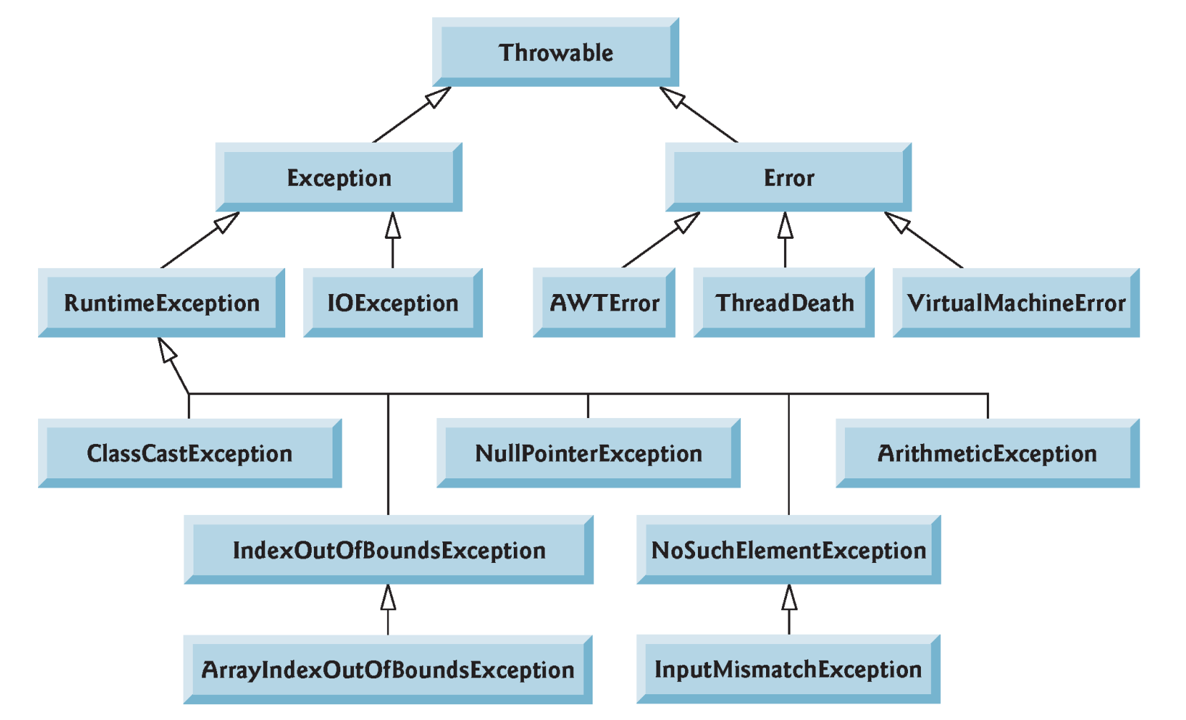
The Exception Hierarchy

Slide 45
Checked & Unchecked Exceptions
Checked Exceptions:
Inherit from Exception class but not from RuntimeException
Compiler enforces catch-or-declare requirement
Unchecked Exceptions:
Inherit from class RuntimeException or class Error.
Compiler does not check code to see if exception caught or declared. So, the programmer will does.

Slide 46
The Main Block of Exception Handling
At the core of exception handling are try and catch. finally is optional.
try {
// block of code to monitor for errors
}
catch (ExcepType1 exOb) {
// handler for ExcepType1
}
catch (ExcepType2 exOb) {
// handler for ExcepType2
}
finally{
//must executed code
}
. . .

Slide 47
throw & throws
throw clause use to throw exception manually when a certain error detection.
Example:
The throws clause tells the caller of the method that it may encounter an Exception. Then the caller needs to handle the exception, or declare that the exception may be thrown.
Example:
if (amount > balance)
throw new IllegalArgumentException("Amount exceeds balance");
balance = balance - amount
public static int divid(int x, int y) throws Exception{
return x / y;
}

Slide 48
File I/O
Data stored in variables and arrays is temporary
It’s lost when a local variable goes out of scope or when the program terminates.
For long-term retention of data, computers use files.
Computers store files on secondary storage devices
hard disks, flash drives, DVDs and more.
Data maintained in files is persistent data because it exists beyond the duration of program execution.
Text/Binary file:
Text: Designed to be read by human.
Binary: Designed to be read by computer (more efficient).

Slide 49
Text File Processing
Write/read to/from text file
public class TestDataText {
public static void main(String[] args) throws IOException{
File file = new File("data.txt");
PrintWriter output = new PrintWriter(file);
output.print("Ahamd CS 87.3");
output.close();
Scanner input = new Scanner(file);
while(input.hasNext())
System.out.println(input.nextLine());
input.close();
}
}

Slide 50
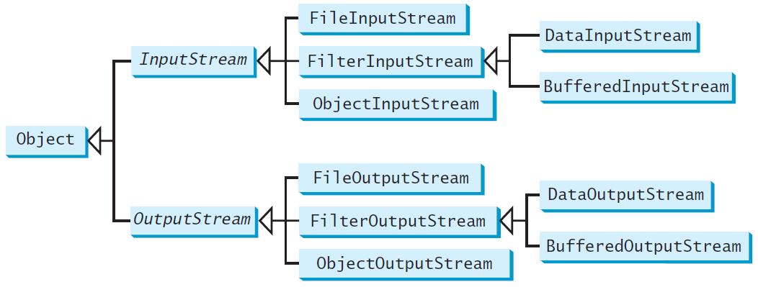
Binary I/O Classes

Slide 51
Binary File Processing
Write/Read to/from binary file
public class TestDataStream {
public static void main(String[] args) throws IOException{
DataOutputStream output = new DataOutputStream(
new FileOutputStream("stud.dat"));
output.writeUTF("Ahmad");
output.writeUTF("CS");
output.writeDouble(87.3);
output.close();
DataInputStream input = new DataInputStream(
new FileInputStream("stud.dat"));
System.out.println(input.readUTF() + " "
+ input.readUTF() + " "
+ input.readDouble());
input.close();
}
}

Slide 52
Collections
A collection is a data structure, actually an object that can hold references to other objects.
Collections cannot manipulate variables of primitive types.
They can manipulate objects of the type-wrapper classes, because every class ultimately derives from Object.
Some Collections Framework Interfaces:
List, Set, Map, Queue
Each framework can be implemented by several classes.
For example, List interface is implemented by ArrayList, LinkedList and Vector.

Slide 53
ArrayList Processing
public class ListColors {
public static void main(String[] args) {
List<String> colors = new ArrayList<String>();
colors.add("Red");
colors.add("Green");
colors.add("Blue");
for(String color : colors)
System.out.println(color);
}
}

Slide 54
Java lambda and Functional Programming
Java lambda expressions are new in Java 8 and they are Java's first step into functional programming.
A Java lambda expression is a function which can be created without belonging to any class, and can be passed around as if it was an object and executed on demand.
Java lambda expressions are commonly used to implement simple event listeners / callbacks, or in functional programming with the Java Streams API.

Slide 55
Java lambda and Functional Programming (cont.)
Prior to Java SE 8, Java supported three programming paradigms:
procedural programming,
object-oriented programming, and
generic programming.
Java SE 8 adds:
functional programming.
Lambda expression
anonymous method that is shorthand notation for implementing a functional interface.
Can be used anywhere functional interfaces are expected.

Slide 56
Functional Interfaces: Example
public class LambdaApp {
public static void main(String[] args) {
Operation<Integer> operation1 =
(num1,num2) -> {return num1 + num2; };
System.out.println(operation1.add(7, 5));
Operation<String> operation2 =
(str1,str2) -> {
str1 = str1.substring(2);
str2 = str2.substring(3, 7);
return str1 + str2;
};
System.out.println(operation2.add
("abcdefg","0123456789"));
}
private interface Operation<T>{
T add(T x, T y);
}
}
Lambda expression
functional interface

Slide 57
That’s it!

